Slide 1
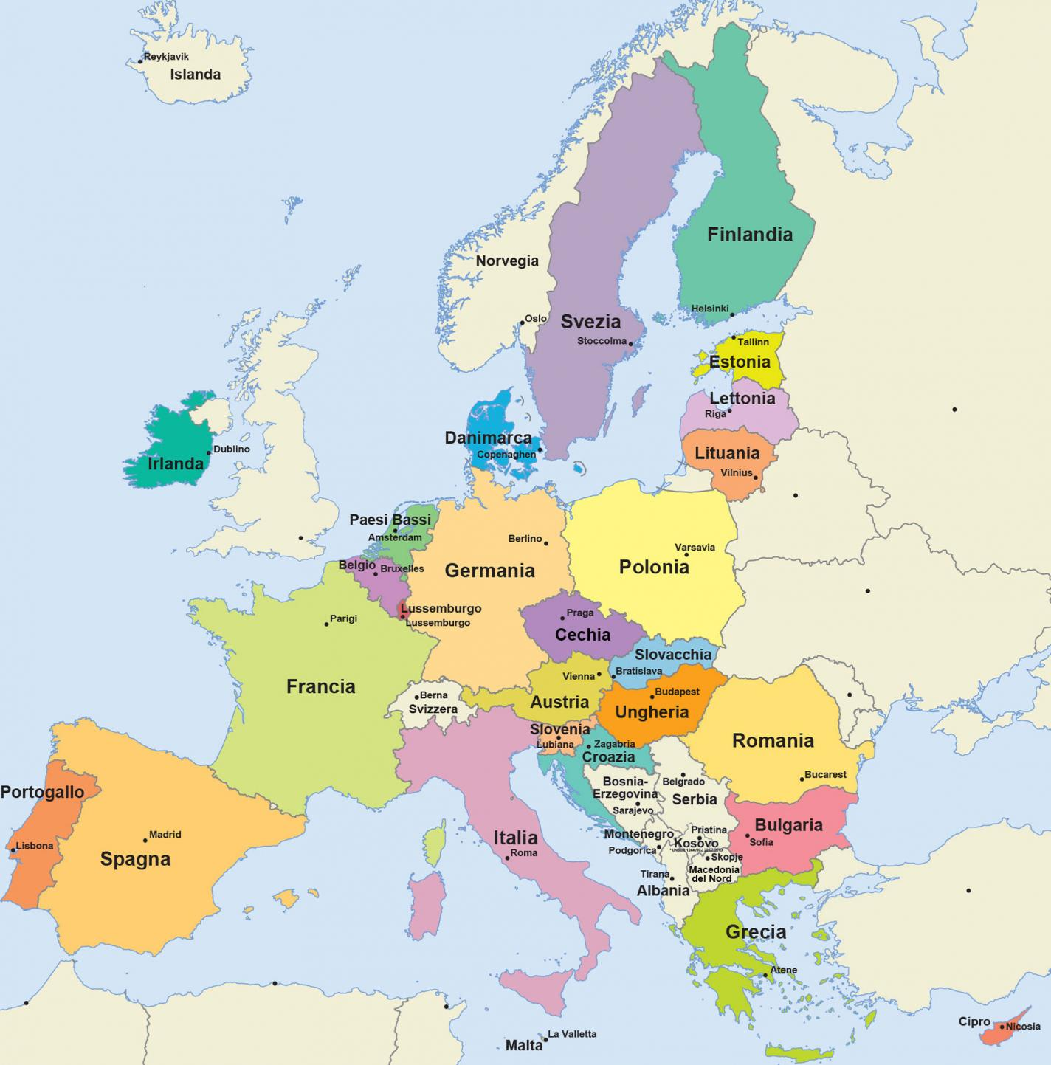



Young Scientists Event
Second Edition

Slide 2
Silvia Bodoardo
Politecnico di Torino
Italy
Welcome

Slide 3
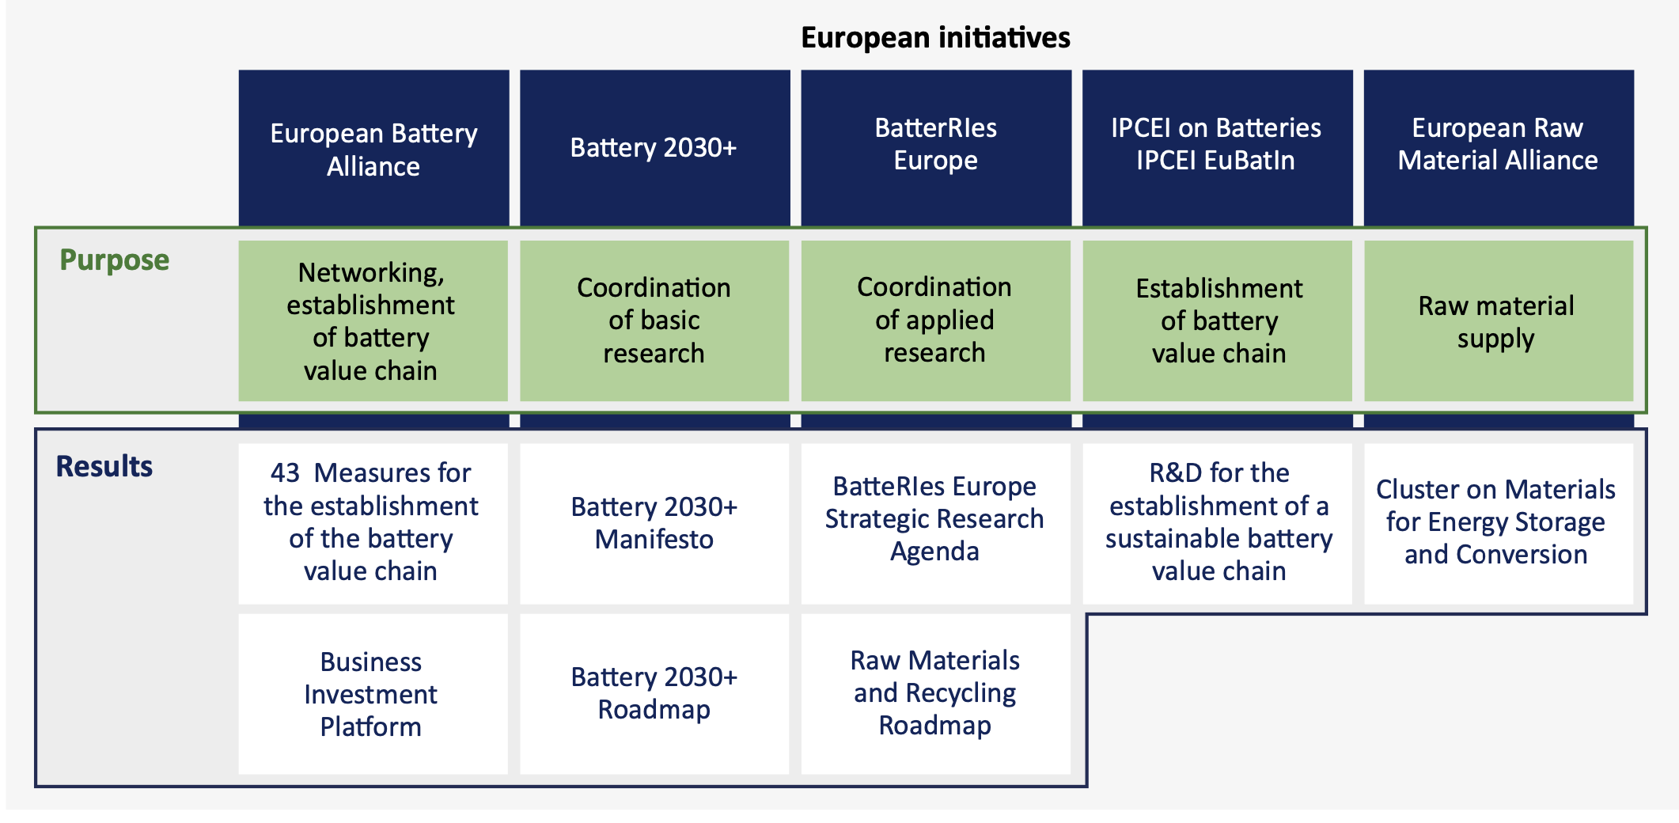
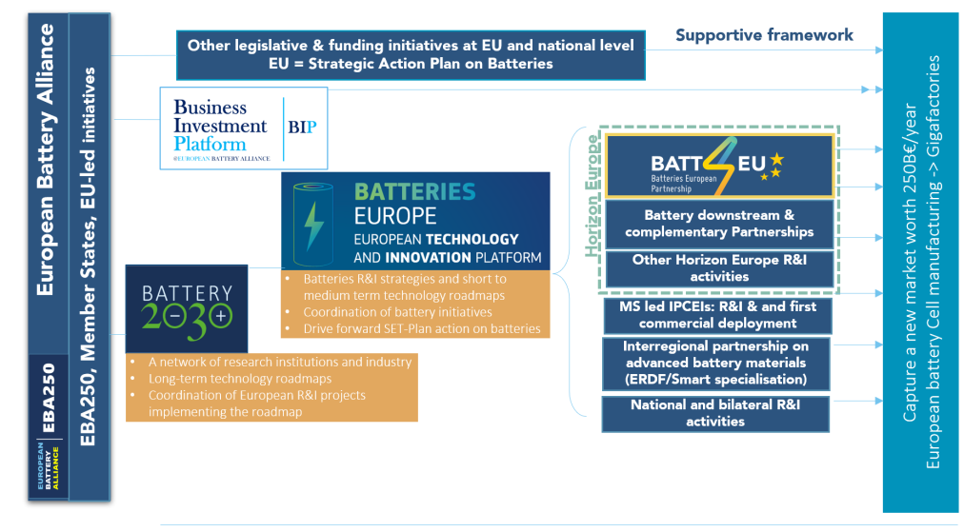
EU Battery R&I landscape
VDI-VDE

Slide 4
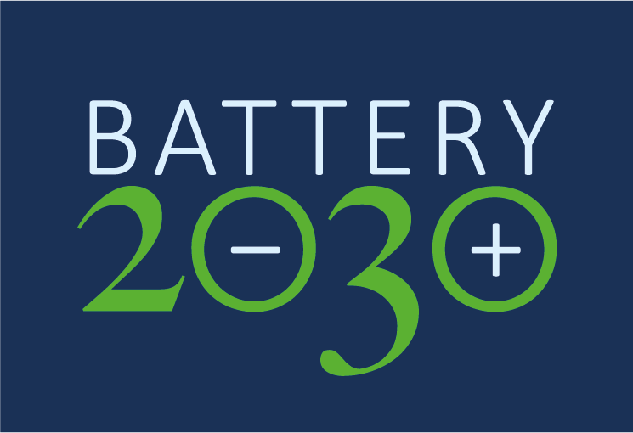
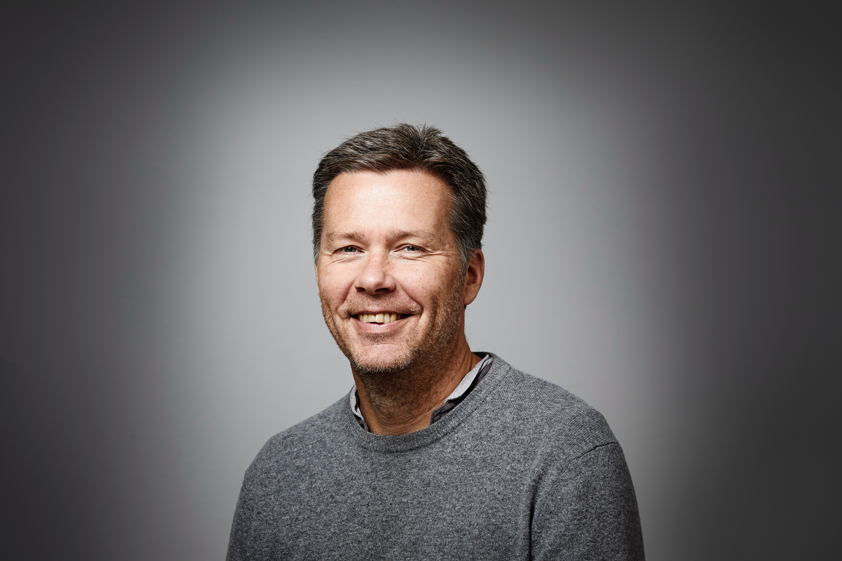
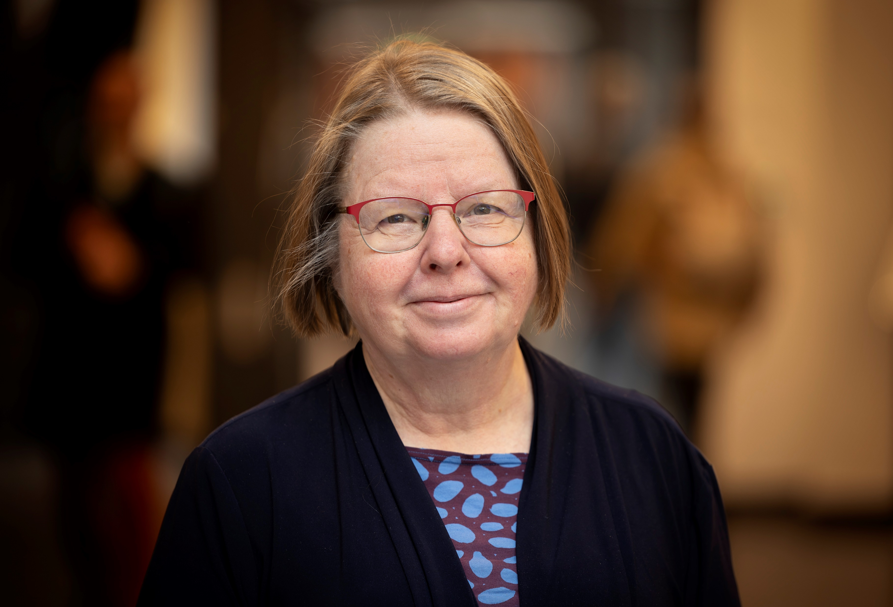
The BATTERY 2030+ Initiative
The vision for BATTERY 2030+ is to invent the batteries of the future, providing European industry with disruptive technologies and a competitive edge across the full value chain, that will enable Europe to take the lead in battery science and technology
Director Patrik Johansson (from March 1st 2025)
Department of Chemistry – Ångström
Uppsala University
SWEDEN
Director Kristina Edström (from 2018-2025)
Department of Chemistry – Ångström
Uppsala University
SWEDEN

Slide 5
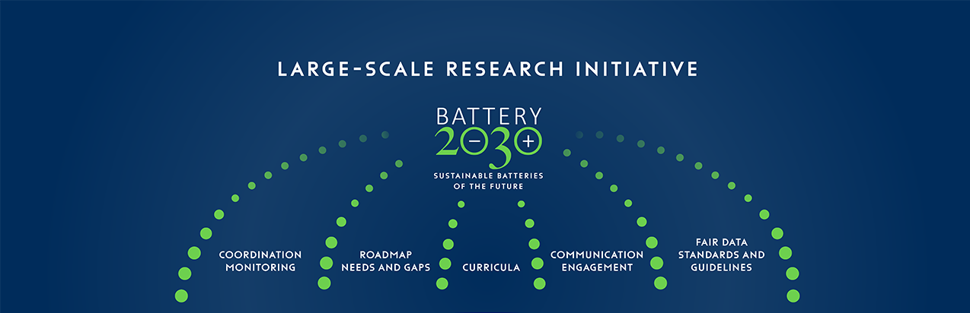















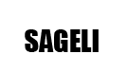

Battery Interface
Manufacturability
Battery Functionality
Accelerated
Materials
Discovery
Raw materials & Recycling

Slide 6
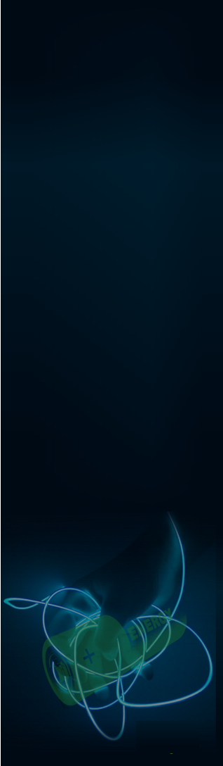



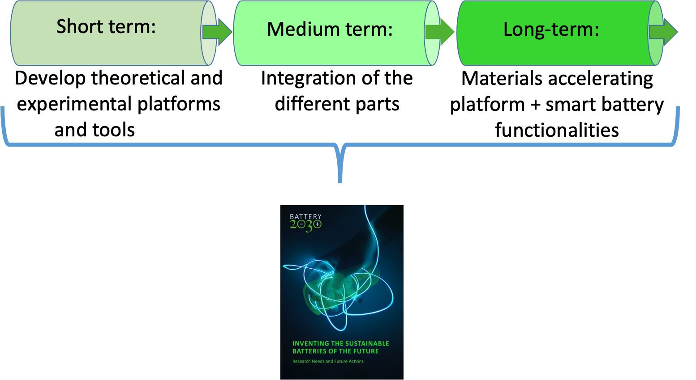
Education:
WP4 New Curricula
EdU Batt Network

Slide 7
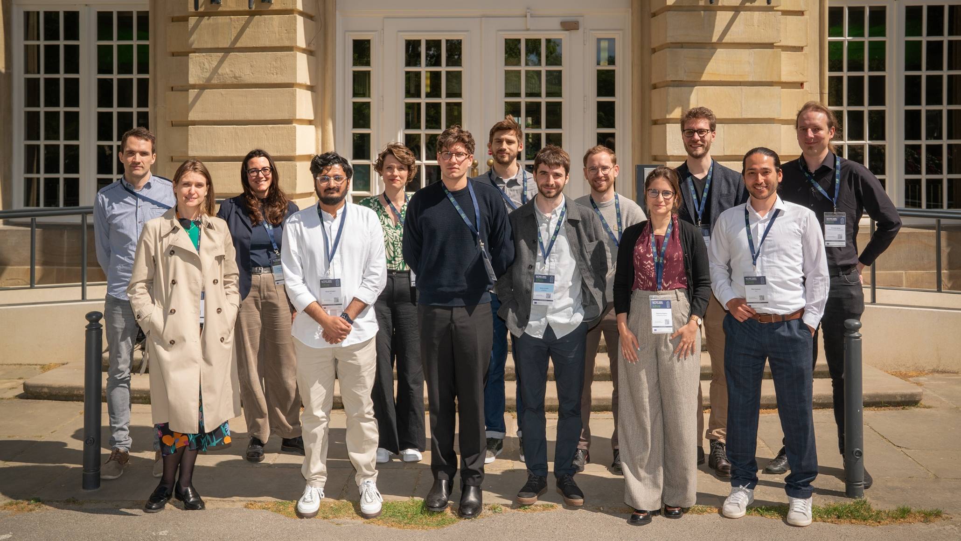
Muenster Young Scientist Discussions

Slide 8
Münster 2025
Decisions taken
Make communication more agile: Early Career Battery Researchers LinkedIn group.
  The existing Teams will be kept as a shared file repository.
Communication campaign to let other ECR know that this network exists.
  Email campaign within labs, across project consortia, and other Battery initiatives.
Series of ECR online seminars will be organised. Format TBD
  ECR research presentations.
  Career talks.
  Soft skills development workshops.
  ….

Slide 9
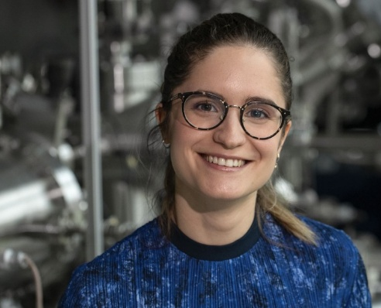
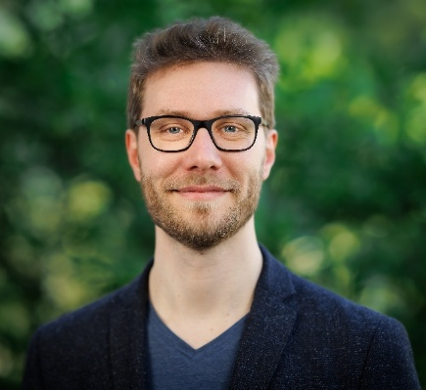
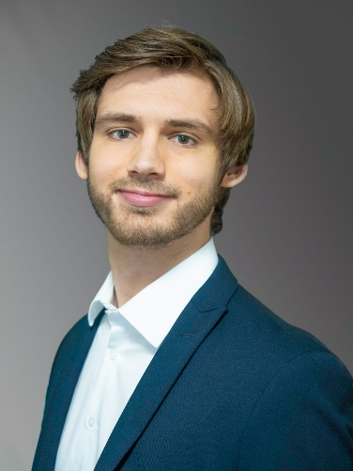
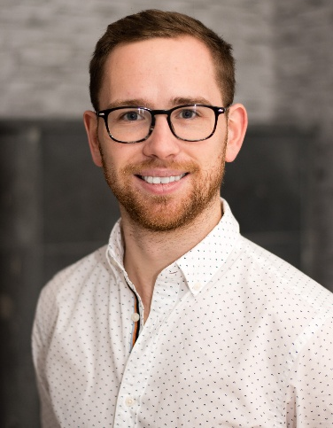
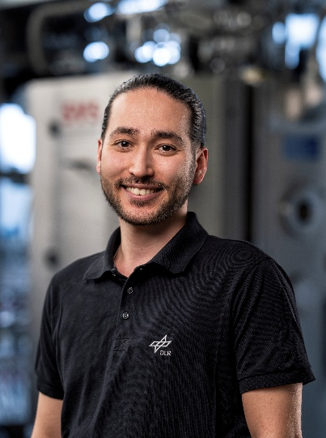
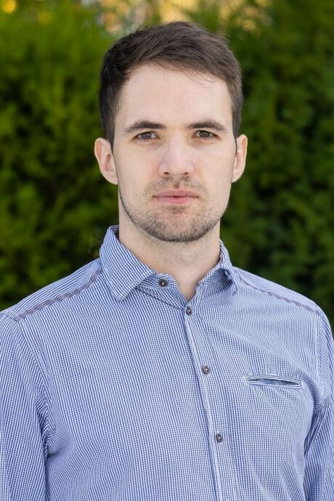
Forschungszentrum Jülich GmbH
Institute of Energy Materials and Devices (IMD)
Meet our YSE board
Dr. Esperanza Sedano Varo
Project Manager of SOLVE, CIDETEC Energy Storage
Solid-state batteries
esedano@cidetec.es
Dr. Jan-Philipp Hoffknecht,
Postdoc,
Helmholtz-Zentrum Berlin
Operando characterization of solid-state sodium sulfur batteries
jan-philipp.hoffknecht@helmholtz-berlin.de
Mr. Simon Albers,
MEET Battery Research Center, HIPOBAT/BACCARA,
Electrode processing and sodium ion anodes
simonalbers@uni-muenster.de
Dr. Dominik Voigt
MEET Battery Research Center
Deputy Head Division Materials
dominik.voigt@uni-muenster.de
Mr. Jan Pleie
Forschungszentrum Jülich GmbH,
Continuum simulation of CAMs
j.pleie@fz-juelich.de
Mr. Bilal Tasdemir,
German Aerospace Center,
Phoenix
Core/shell structured NMC
Bilal.tasdemir@dlr.de

Slide 10
6 Universities involved
around 160 young scientists involved
Homogeneous tables composition
One table leader
Role of Table leader:
Coordinate the works of each table
Take note of what discussed
Summarize the work of each table
Draft the manifesto
Meet other table leaders to finalize the manifesto

Slide 11
Reference person per university
CNRS Amiens. Emma Prevignano
Vrije Brussels University Kato Daems
Fraunhofer ICS Wurzburg Guinevere Giffin
Politecnico di Torino Silvia Bodoardo
Uppsala University Andy Naylor and Kajsa Saykali
Warsaw Technical University. Marek Marcinek

Slide 12

Final scope
Prepare the Manifesto of Young Scientists in Europe:
REDESIGN THE BATTERY OF OUR FUTURE
Define a title of the Manifesto
Define a motto
The Manifesto will be presented in the Nanoinnovation conference
15-19 September 2025 Rome -Italy
https://www.nanoinnovation2025.eu/home/

Slide 13
Topics:
Novelties in battery area: next generation batteries (e.g., solid state, Si-anode, advanced LiB, smart functionalities).
Sustainable systems, recycling and second life, circular economy.
Industry and EU regulations, how to commercialize a product, sustainable production processes.

Slide 14
The Agenda
9.00 | Welcome | Silvia Bodoardo POLITO
 | European Commission | Johan Blondelle European Commission
 | Battery2030 | Patrik Johansson/ Kristina Edström Uppsala
09.30 | Round table of hosting universities | POLITO, Uppsala, VUB, WUT, CNRS, FHG ISC
09.45 | 15 min presentation of participants around tables
10.00 | Novelties in battery area: next generation batteries | Mathieu Morcrette (CNRS Amiens)
10.10 | Round table - free discussions
11.00 | Sustainable systems, recycling and second life, circular economy | Witold Uhrynowski (Warsaw)
11.10 | Round table - free discussions
12.00 | Sustainable production processes. How to learn from mistakes | Ilka Von Dalwigk (Recharge)
12.10 | Round table - free discussions
13.00 | LUNCH
14.30 | Industry and EU regulations | Stefan Wolf (VDI-VDE)
14.40 | How to commercialize a product | Elena Bonvecchio (BEPA)
14.50 | Round table - free discussions
15.30 | Societal impacts of electrification and bureaucracy | Stefano Corgnati (Politecnico di Torino)
15.40 | Round table - free discussions
16.20 | Each table prepares a summary
16.50 | Table leaders combine summaries
17.10 | Each university presents the results online
18.10 | Conclusions | Silvia and Kristina

Slide 15
How to write the Manifesto
Written online
Weekly meetings on teams
The document is preliminary written by table leaders in 5 weeks (first week of July)
Shared with all participants who can add/modify and then eventually discuss
Delivered by the end of July and published on Battery2030 website beginning of August
Presented by table leaders at Nanoinnovation conference in September 2025 in Rome

